Slide 1
CTL Data Warehouse Current State
Sources
Data Marts (Business and IT)
Reporting
Business
Marketing BOAs
Data Warehouses (IT)
B360
Corp Strategy BOAs
Operations BOAs
Legacy Warehouses
C360
CSDM
PC360
SPLUNK
Combined Company
Warehouses
Funding has Limited
Integration & Decom of Legacy Warehouses
Network Operations BOAs
CAFF II
Reporting
Finance BOAs
CTL EDW
Legacy CTL
CDNA
CDBI
Call Center
BOAs
CDW/EDW
Legacy Qwest
Ethernet
Business Objects Reporting
DWOPS (OSS)
SDSA
Sales BOAs
One Qwest
Legacy Qwest
Customer Care BOAs
Basecamp
Legacy Qwest
CCDW (BSS)
IT
SAGE
Legacy Savvis
Operations
Finance
Marketing
DWODS (Near Real Time, Very Limited)
SPLUNK
SMART
Legacy Savvis
Engineering &
Construction
PCM
CRDM
Legacy Qwest
Sales to Billing
MKIS
Legacy Embarq
Wholesale Data Mart (WDM)
BDM
Legacy Qwest
Data Lake (Limited to a few use cases so far)
Landing Zone Raw +
Use Case Specific Data, Some Integration
Aggregated CRM Marketing Data
Call Detail – ON HOLD,
Enterprise Marketing, Lead Generation Spark Models
Network Device Data and Logs

Slide 2
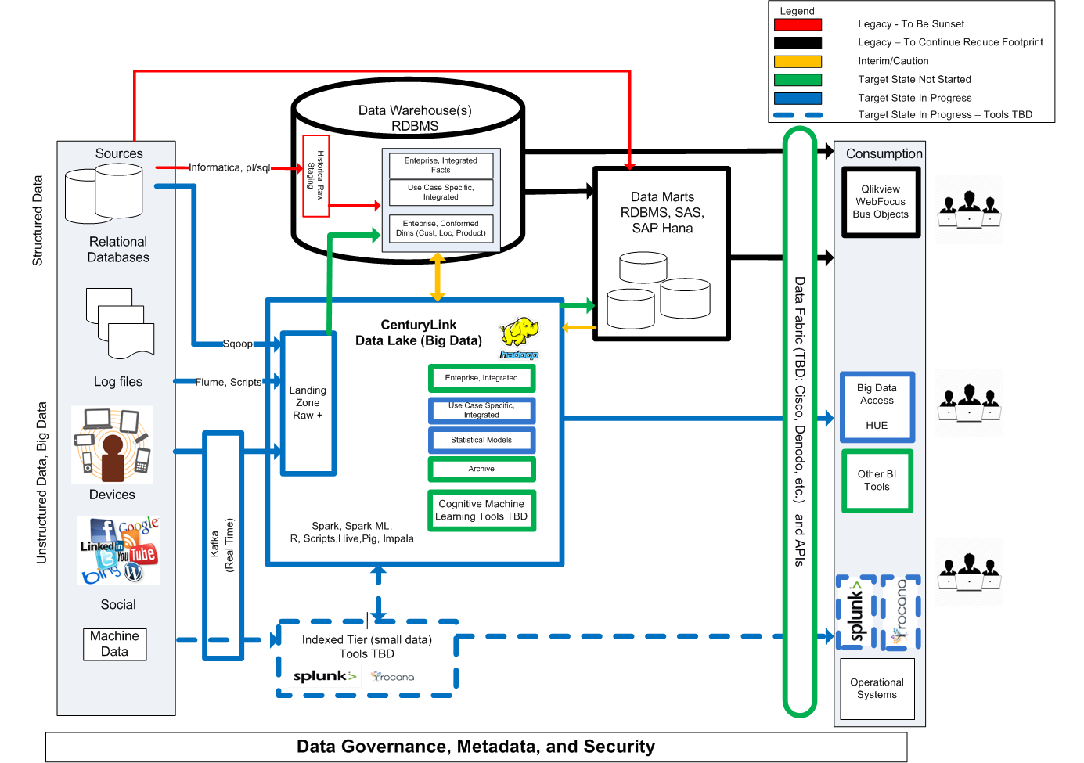

Slide 3
CCDW – Combined Company Data Warehouse (BSS)
Sources
(Billed Dollars, In Service Units, Customer, Product,
Location)
Staging
CCDW – Modeled
Basecamp
(STAGE Schema)
Enterprise
Legacy Qwest Billing
ENTP
CTLQWEST
CRIS
Customer
Customer
DIM
Product
DIM
Primarily
Business
Objects
&
Direct Access
LATIS
RJF
Product
Journal Detail Fact
Oracle
Network
Service
Location
Ending In Service Fact
Legacy Savvis
BRM/VANTIVE
Product Activity Fact
Legacy Embarq
CABS
Sales Orders
TBD –
See federated order slide
PPP (Prepaid Billing)
Service Location
DIM
CDMT
Business Reference Data
CDW (CRIS data warehouse)
Network & Inventory Tables
Dept (DWDPTORA Schema)
MARTENS (Ensemble Network)
Sales Order Value Fact
(Enterprise Orders and Values)
Sales to Billing Data Mart
PROD_R – LATIS
Point Solution Tables
Legacy CTL
Ensemble
CTL EDW

Slide 4
Cust Acct Dim
CUST_ACCT_DIM_ID | NUMBER(38) | Surrogate Key | ADDR_TRTRY_STR_LINE | VARCHAR2(91) | Wholesale
CUST_ACCT_ID | VARCHAR2(20) | Natural Key (native to billing system) | WHLSL_PRNT_CO_ID | NUMBER(38) | Wholesale
BILL_SRC_SYS_CD | VARCHAR2(16) | Natural Key (billing system) | WHLSL_PRNT_CO_NM | VARCHAR2(100) | Wholesale
MSTR_CUST_ID | VARCHAR2(11) | Conformed | WHLSL_CUST_CRPTN_CD | VARCHAR2(5) | Wholesale
MSTR_CUST_NM | VARCHAR2(60) | Conformed | WHLSL_CUST_ADT_NBR | VARCHAR2(16) | Wholesale
ACCT_ESTABLISHED_DTTM | DATE | Conformed | WHLSL_BUS_OFC_ID | VARCHAR2(4) | Wholesale
ACCT_DSCNCT_DTTM | DATE | Conformed | WHLSL_SCTR_NM | VARCHAR2(15) | Wholesale
ACCT_DSCNCT_CD | VARCHAR2(4) | Conformed | WHLSL_SLS_TEAM_NM | VARCHAR2(15) | Wholesale
BTN | VARCHAR2(40) | Conformed | WHLSL_LD_PRNT_CO_NM | VARCHAR2(100) | Wholesale
BTN_NPA | VARCHAR2(3) | Conformed | CRNT_CUST_SGMNT_SRC_NM | VARCHAR2(30) | Realignment
BTN_NXX | VARCHAR2(3) | Conformed | CRNT_CUST_SGMNT_UPD_DTTM | DATE | Realignment
BTN_LINE | VARCHAR2(4) | Conformed | PRR_ANL_RLGN_CUST_SGMNT_CD | VARCHAR2(20) | Realignment
CUST_FULL_NM | VARCHAR2(80) | Conformed | PRR_ANL_RLGN_MKT_SGMNT_CD | VARCHAR2(30) | Realignment
ADDR_ATTN_TO_TXT | VARCHAR2(64) | Conformed | PRR_ANL_RLGN_MKT_SGMNT_DESC | VARCHAR2(50) | Realignment
ADDR_PRI_STR_LINE | VARCHAR2(120) | Conformed | PRR_ANL_RLGN_CUST_SALES_REP_ID | VARCHAR2(25) | Realignment
ADDR_SEC_STR_LINE | VARCHAR2(91) | Conformed | ANL_RLGN_CUST_SGMNT_CD | VARCHAR2(20) | Realignment
ADDR_CITY_NM | VARCHAR2(64) | Conformed | ANL_RLGN_MKT_SGMNT_CD | VARCHAR2(30) | Realignment
ADDR_ST_CD | VARCHAR2(10) | Conformed | ANL_RLGN_MKT_SGMNT_DESC | VARCHAR2(50) | Realignment
ADDR_ZIP_CD | VARCHAR2(15) | Conformed | ANL_RLGN_CUST_SALES_REP_ID | VARCHAR2(25) | Realignment
ADDR_ZIP_CD_PLUS_4 | VARCHAR2(10) | Conformed | MNTH_RLGN_CUST_SGMNT_CD | VARCHAR2(20) | Realignment
ADDR_CNTRY_CD | VARCHAR2(30) | Conformed | MNTH_RLGN_MKT_SGMNT_CD | VARCHAR2(30) | Realignment
DFLT_SUB_MKT_CD | VARCHAR2(5) | Unique to Billing Systems | MNTH_RLGN_MKT_SGMNT_DESC | VARCHAR2(50) | Realignment
BILL_CYCLE_CD | NUMBER(38) | Unique to Billing Systems | MNTH_RLGN_CUST_SALES_REP_ID | VARCHAR2(25) | Realignment
CRNT_CUST_ACCT_STUS_CD | VARCHAR2(1) | Conformed | CUST_ACCT_CHAN_ID | VARCHAR2(12) | Unique to Billing Systems
CRNT_CUST_ACCT_TYPE_CD | VARCHAR2(2) | Conformed | PRTNR_REP_ID | VARCHAR2(12) | Conformed
CRNT_CREDIT_CLS_CD | VARCHAR2(1) | Conformed | CUST_ACCT_TMNT_CLASS_CD | VARCHAR2(1) | Unique to Billing Systems
CRNT_RESLR_IND_CD | VARCHAR2(1) | Conformed | LANG_CD | VARCHAR2(5) | Unique to Billing Systems
RESLR_CD | VARCHAR2(4) | Unique to Billing Systems | MLT_DWLG_UNIT_CD | VARCHAR2(2) | Unique to Billing Systems
CRNT_CUST_ACCT_SUB_TYPE_CD | VARCHAR2(1) | Unique to Billing Systems | CUST_ACCT_LINK_ID | NUMBER | Conformed
CRNT_CUST_ACCT_STUS_EFF_DTTM | DATE | Conformed | SINGL_BILL_PRSTN_SRC_SYS_CD | VARCHAR2(16) | Conformed
CRNT_CUST_SALES_REP_ID | VARCHAR2(25) | Conformed | SINGL_BILL_PRSTN_CUST_ACCT_ID | VARCHAR2(19) | Conformed
CRNT_CUST_SGMNT_CD | VARCHAR2(20) | Conformed | POST_MGRTN_SRC_SYS_CD | VARCHAR2(16) | Conformed
CRNT_FED_USF_EXEMPT_TYPE_CD | VARCHAR2(20) | Conformed | POST_MGRTN_CUST_ACCT_ID | VARCHAR2(40) | Conformed
CRNT_MKT_SGMNT_CD | VARCHAR2(30) | Conformed | CVOIP_RCR_PROD_ACCT_ID | NUMBER | Unique to Billing Systems
CRNT_MKT_SGMNT_DESC | VARCHAR2(50) | Conformed | ASOC_ENS_CUST_ACCT_ID | VARCHAR2(40) | Unique to Billing Systems
DISC_GRP_ID | VARCHAR2(20) | Unique to Billing Systems | CLD_SVS_RCR_PROD_ACCT_ID | NUMBER | Unique to Billing Systems
CRIS_MCN_CD | VARCHAR2(20) | Unique to Billing Systems | WRLS_RCR_PROD_ACCT_ID | NUMBER | Unique to Billing Systems
RESLR_TYPE_CD | VARCHAR2(20) | Unique to Billing Systems | DTV_RCR_PROD_ACCT_ID | NUMBER | Unique to Billing Systems
ALT_CUST_ACCT_SEQ_NBR | NUMBER(38) | Unique to Billing Systems | ALL_RCR_PROD_ACCT_COMBN_TXT | VARCHAR2(520) | Unique to Billing Systems
ALT_CUST_ACCT_ID | VARCHAR2(20) | Unique to Billing Systems | BRM_VERT_MKTG_SGMT_NM | VARCHAR2(50) | Unique to Billing Systems
BILL_TO_CUST_ACCT_ID | VARCHAR2(19) | Conformed | BRM_VERT_MKTG_SGMT_RLUP_NM | VARCHAR2(30) | Unique to Billing Systems
BILL_TO_SRC_SYS_CD | VARCHAR2(16) | Conformed | BRM_BUS_PRTNR_CUST_ID | VARCHAR2(20) | Unique to Billing Systems
MCN_ACCT_MKT_SGMNT_CD | VARCHAR2(1) | Unique to Billing Systems | ACQN_ACCT_SALS_REPTV_EMPL_ID | VARCHAR2(20) | Unique to Billing Systems
MCN_ACCT_MKT_FCN_INDUS_GRP_CD | VARCHAR2(1) | Unique to Billing Systems | ACQN_ACCT_SALS_REPTV_NM | VARCHAR2(100) | Unique to Billing Systems
MCN_ACCT_MKT_CUST_CD | VARCHAR2(4) | Unique to Billing Systems | SMRY_BAN | VARCHAR2(13) | Unique to Billing Systems
ACNA | VARCHAR2(5) | Unique to Billing Systems
DISC_GRP_TYPE_CD | VARCHAR2(12) | Unique to Billing Systems
ROW_STUS_CD | VARCHAR2(1) | Meta Data Column
META_HCAAD_UPD_IND_CD | VARCHAR2(1) | Meta Data Column
META_HCSD_UPD_IND_CD | VARCHAR2(1) | Meta Data Column
META_LOAD_TMSTMP | TIMESTAMP(9) | Meta Data Column
META_LOAD_PROC_ID | NUMBER | Meta Data Column
META_UPD_TMSTMP | TIMESTAMP(9) | Meta Data Column
META_UPD_PROC_ID | NUMBER | Meta Data Column
META_HCAAD_CHECKSUM_ID | VARCHAR2(32) | Meta Data Column
META_HCSD_CHECKSUM_ID | VARCHAR2(32) | Meta Data Column
META_CHECKSUM_ID | VARCHAR2(32) | Meta Data Column

Slide 5
Cust Acct Dim – Dispostion
The Good
All accounts in one place (consumer, business, and wholesale). This is the only complete source in the company.
Includes governed customer segmentation assignment
Includes governed master customer id/name for enterprise customers
Tied to CCDW fact tables
Most dependent marts use it as a source (even if they ‘enhance’ it with additional attribution)
The Not So Good
Built with CTL/Qwest Merger as part of “Day 1 Reporting” – Quick and Dirty
Has Lived On – Enhanced as Project Funding Allows, But Limited
Needs Care & Feeding
There are “duplicates”
Some “conformed fields” have never been populated for some billing systems.
It is dependent on legacy warehouses, too much latency
It needs TLC in terms of data quality improvements
Suggested Roadmap
Move sourcing towards near real time – move off of legacy warehouses
Needs some investment dollars to improve data quality and consistency

Slide 6

Product Dim - Conceptual
Billing Systems
Product Native Elements
Finance Standard 5 Digit Product Code
Governed by Finance
Via CDMT
Finance Product Hierarchy
Governed by Finance
Via CDMT
Partial Mapping
Sales Channel Product Definitions
Sales Channel Product Hierarchy
Operational Product Catalog(s)

Slide 7
Network Location Service Location Dim - Conceptual
Network Circuits
Network Circuit Location XREF
Associate to circuit information on “event” records.
Not all “events” have this detail, therefore default rollups get assigned
Using network elements because “service address” is not available on most events
Location Information of Circuits

Slide 8
Cust Acct Dim
select a.bill_src_sys_cd, count(distinct cust_acct_id)
from cust_acct_dim a, jrnl_detl_fact b
where a.cust_acct_dim_id = b.cust_acct_dim_id
and b.jrnl_yr_mnth_nbr = 201703
group by a.bill_src_sys_cd
BILL_SRC_SYS_CD | COUNT(DISTINCTCUST_ACCT_ID)
ENS | 3,655,824
CRISC | 3,182,370
CRISE | 1,359,179
CRISW | 1,267,159 | 5,808,708 | CRIS Total
LATIS | 1,772,621
SSW | 71,195
CABS | 12,302
ORACLE2E | 8,267
BRM | 7,344
BART | 3,449
NIBS | 3,084
LEXCIS | 901
AMORT | 206
SAP | 17
AFFLUSWC | 15
REVBC | 14
MCSS | 7
REVMCJS | 2

Slide 9
Journal Counts
select jrnl_trans_type_cd, sum(jrnl_trans_amt), count(*)
from jrnl_detl_fact b
where jrnl_yr_mnth_nbr = 201703
group by jrnl_trans_type_cd
JRNL_TRANS_TYPE_CD | SUM(JRNL_TRANS_AMT) | COUNT(*)
BILLING | 1,607,338,280 | 322,973,186
ADJUSTMENT | (31,997,065) | 2,797,208
ACCRUAL | 11,887,801 | 147,351,679
RECLASSIFICATION | 2,713,953 | 35,532,608
NONREVENUE | 907,380,774 | 99,491,478
BILLING_OVERLAY | 5,341,934 | 4,216
BILLING_BRDMOVRLY | - | 12

Slide 10
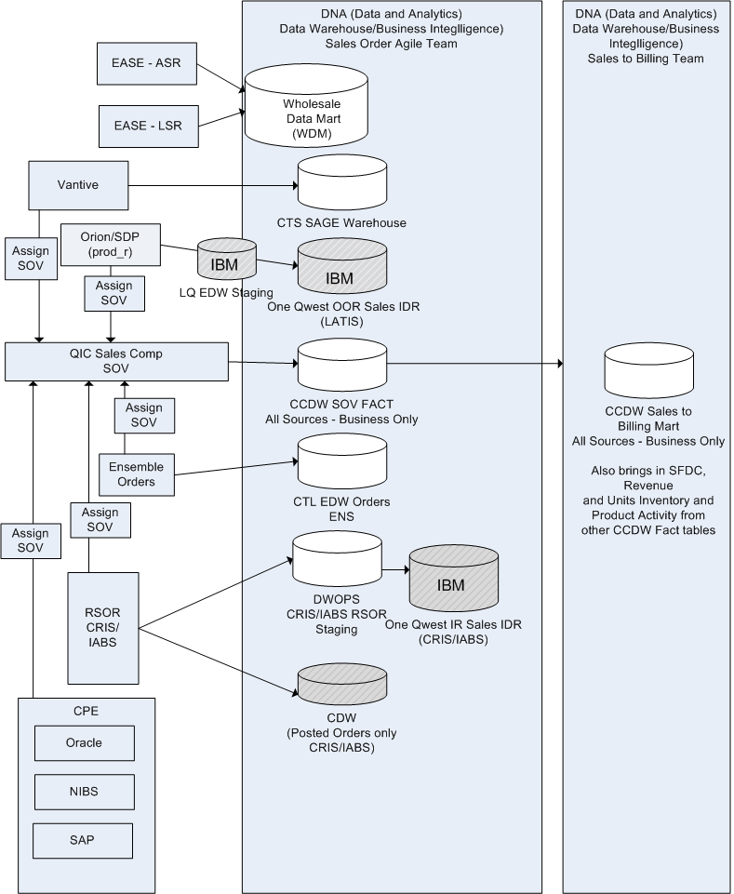
Federated Sales Orders in Warehouse Landscape (its not pretty)

Slide 11
Provisioning and Order Analytics Architecture – Pending final funding approval
Sources
Consumption
Sales Orders
Warehouse
Staging
DWOPS/
Basecamp
Majority Already
Staged in DWOPS
(Will Evaluate Consolidation of Staging)
Warehouse
Integrated (DWOPS)
ENS-O
SOV?
“PODAA”
SDP/Orion
Sales to Billing
CCDW mart
Vantive
Integrated Sales Order Asset – with SOV added
Customer
RSOR
EASE
Sales Order to Provisioning Order XREF
Product
PODAA Application Suite
Rev Acceleration, Ethernet,
ITOT,
Pronto
Integrated Provisioning Order
Asset
Location
Provisioning Orders
WFAC
Provisioning Order to Engr/
Construction Order XREF
Application Reporting Tables
ENS-O
Integrated Engineering/
Construction Order Asset
CORE
Vantive
TIRKS
DSP
Integrated Workflow/
JobStep Asset
API
DSP
Order Workflow
Mgr
Engr/Construction Orders
WFMT
Fireworks
Data Lake (Hadoop)
ARMOR
Inventory
OVS

Slide 12
DWOPS Overview Diagram – NI, SDSA Focus

Slide 13
DWODS Overview

Slide 14
CTL EDW– Ensemble Warehouse - Legacy CTL BSS/OSS
Sources
Staging
Modeled
Ensemble
Order Management System
Dim Schema (Ensemble only)
Order Management System
Customer Service Management
Customer
Product
Geography
Customer Service Management
Billing
Facts
Billing
Model Office
Ending In Service
Model Office
Martens
Activity
Remedy
Revenue
Provisioning/Trouble Ticketing/
Martens
WFM
Activity Reasons
Sales Channel
Remedy
CABS Billing
WFM
Acxiom Demographics
Dept
AVAYA IVR
Prism Data mart
CABS Billing
Revenue Summary
Acxiom Demographics
IRDM
AVAYA IVR

Slide 15
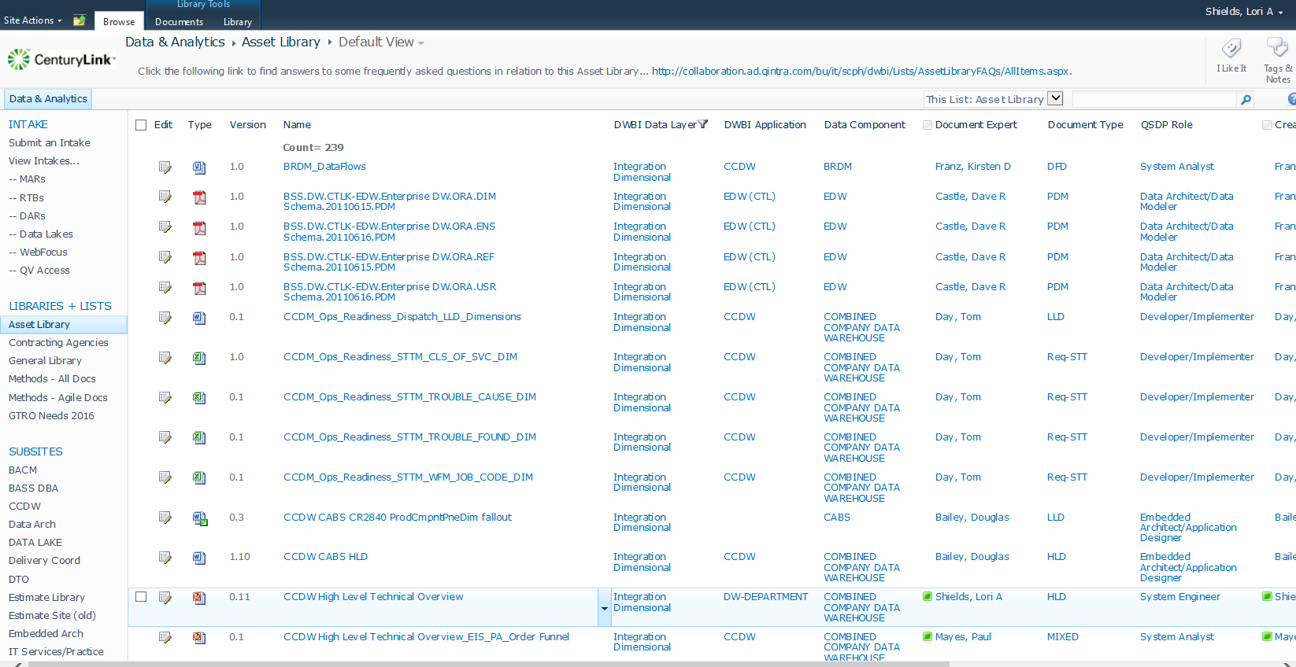
Reference to Data Asset Site – STTs, Data Models, design docs
http://collaboration.ad.qintra.com/bu/it/scph/dwbi/DWBIAssetLibrary/Forms/AllItems.aspx

Slide 16
DNA-NI Overview

Slide 17
DNA-SDSA Overview

Slide 18
Building Blocks (Tools & Technologies)
Under Evaluation
In Use
Serve
Unified Services
Data Virtualization
User Interface
HUE
Analytic Dashboards
HUNK
Search
SOLR
Scheduling
Oozie, CRON
BI Tools (TBD)
Integrate and Model
Data Mgmt
Navigator
IBM Watson
Batch
Spark, Hive, Pig, MapReduce
SQL
Impala
Stream
Spark
Machine Learning
Spark ML
Jupyter
Notebook
Model
Controller
StreamAnalytix
Security
Sentry
Splunk
StreamSets+Rocana
Pentaho
Store
Informatica
Cask
File System
HDFS
HBase
Graph DB
Resource Mgmt
Yarn
Data Ingestion
Operations
Cloudera Manager
Batch
Sqoop, Flume
Real-Time
Kafka, Flume
Increase Development Velocity/Ease of Use
Integration with RDBMS/Data Virtualization
Dashboard Creation & Reporting
Streaming Analytics & Operations
Machine Learning/Artificial Intelligence
Included With Cloudera Stack

Slide 19
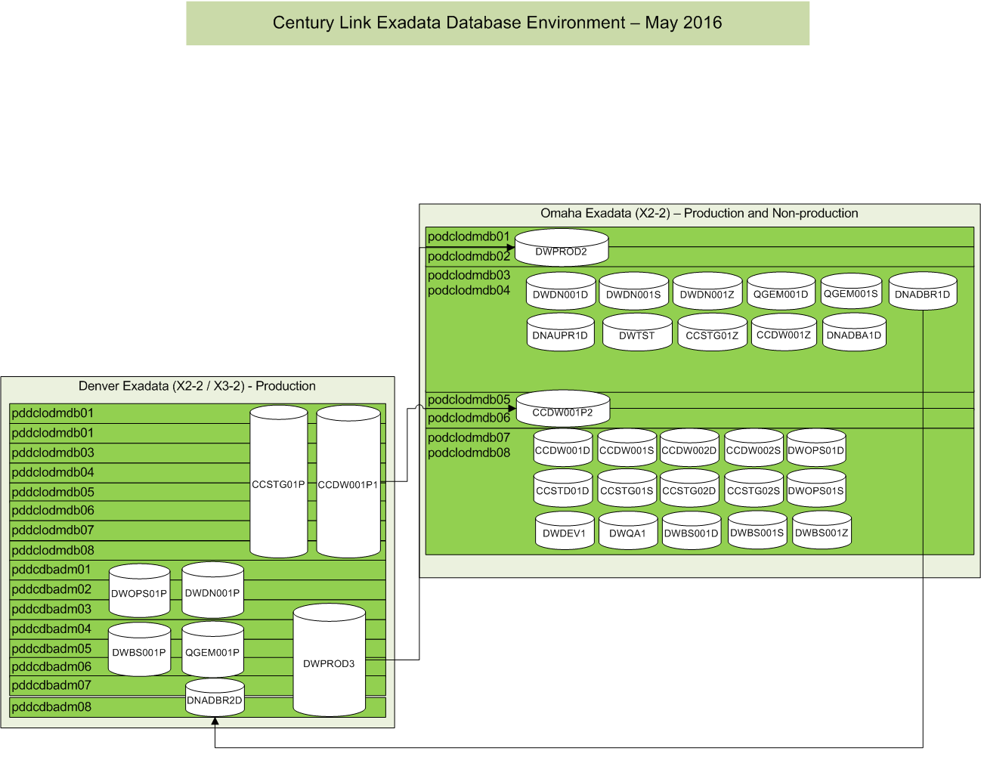

Slide 20
Hadoop Topology
Omaha
Denver
TCE
Prod
CI
Dev/Test
Sandbox
DR
Lab (POCs)
30
Data Nodes
14
Data Nodes
20
Data Nodes
13
Data Nodes
10GB shared
20
Data Nodes
6
Data Nodes
8
Edge Nodes
8
Edge Nodes
8
Edge Nodes
3
Edge Nodes
4
Edge Nodes
1
Edge Nodes
7
Mgt / Sec Nodes
7
Mgt / Sec Nodes
7
Mgt / Sec Nodes
7
Mgt / Sec Nodes
7
Mgt / Sec Nodes
7
Mgt / Sec Nodes
216 TB
100TB
144TB
140TB
10GB dedicated
144TB
180TB
Managed fidelity on information to/from network edge
Needed:
5 Data Nodes
4 Edge Nodes
7 Mgt/Sec Nodes
120 TB
~$150K
Cloud Edge Compute (CEC) “Pod”
CTL Network
CEC Pod
SDN / NFV
Hadoop
Data Nodes
Legend:
Edge Nodes
Complete
Mgt / Sec Nodes
Build-out In Progress
Future
Obsolete / Needs Investment
CEC Pod
CEC Pod

